Slide 1
Innovatum
Insatser För Asylsökande
Abdulrahman Sinjab

Slide 2
Vision:
Our idea is to keep these heritages active and more its to let the new comer's know more about the history
Of Sweden step by step in different ways and to find those who are interested to be a part in some places

Slide 3
Steps:
- Looking for the refugees camps that doesn't have much activities .
- Finding a contact person in those camps .
- Communicate with them for advertising
and organizing the people.

Slide 4
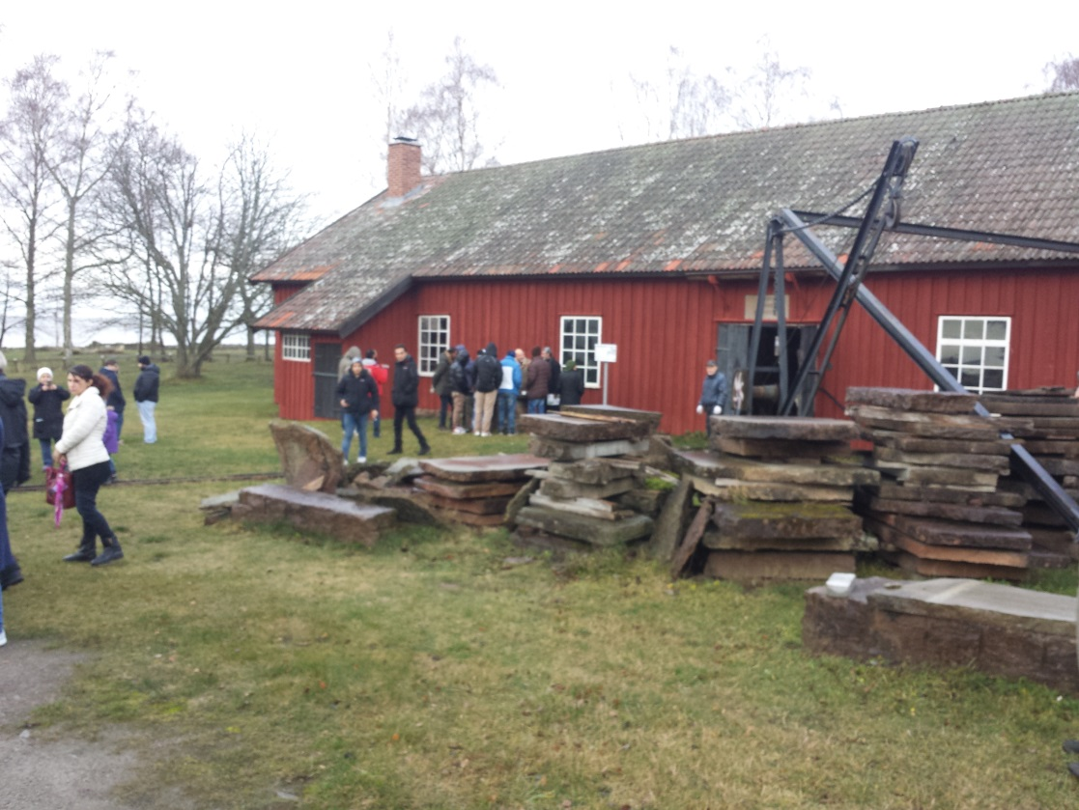
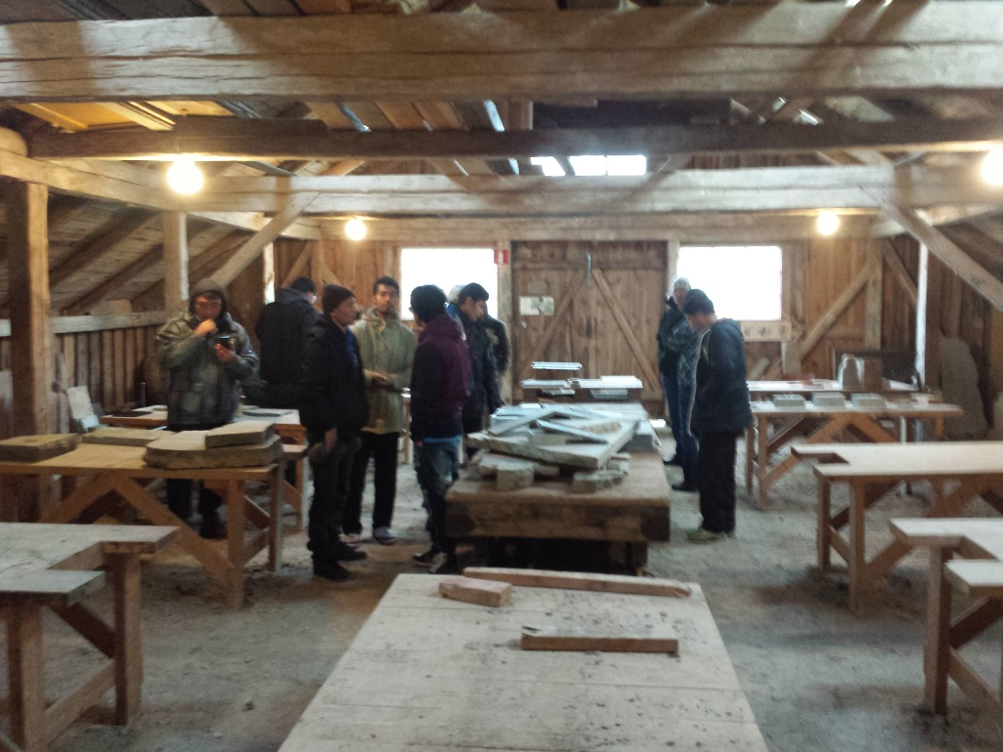
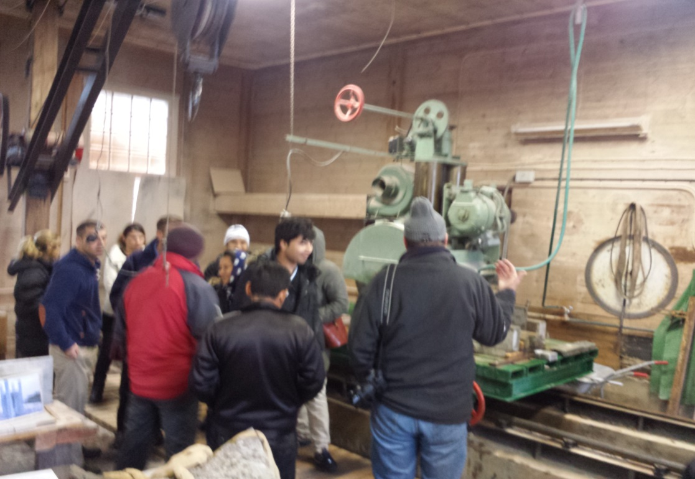
In 28-11-2015 a group of 60 people from Kinnekulle camping have been to Råbäcks Mekaniska Stenhuggeri.

Slide 5
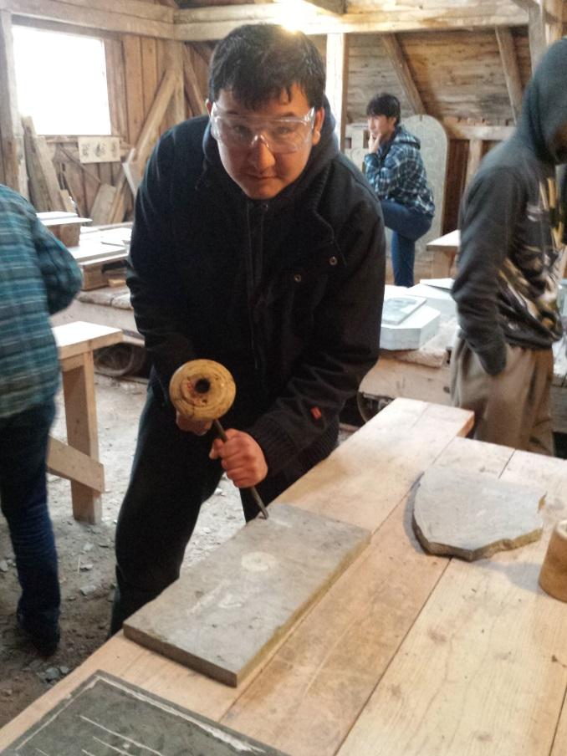
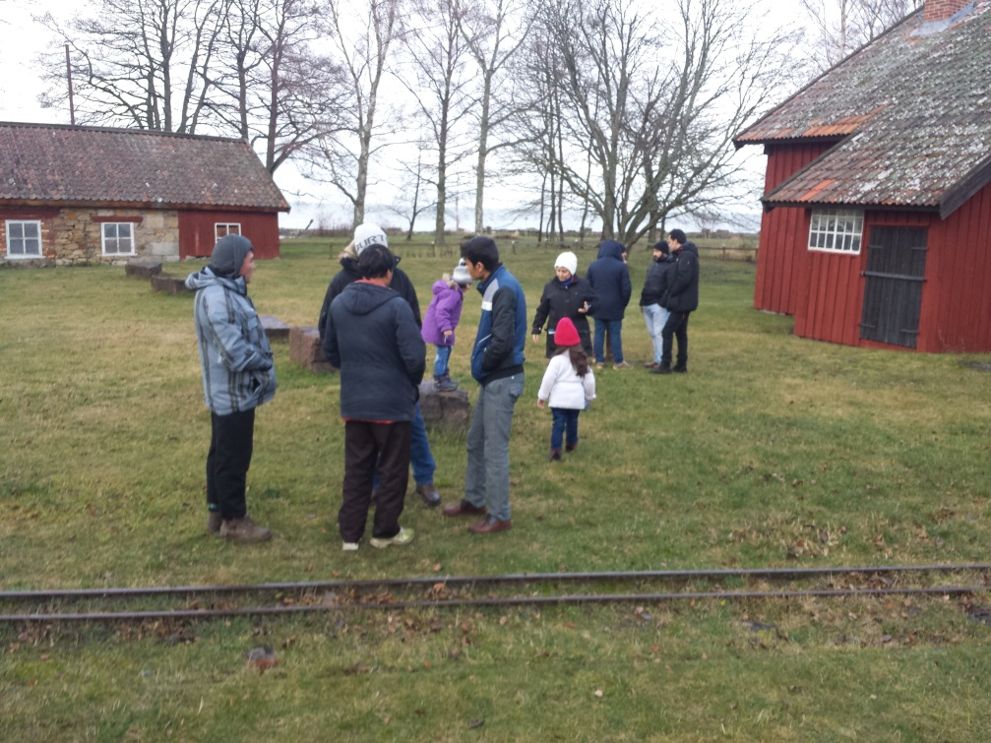
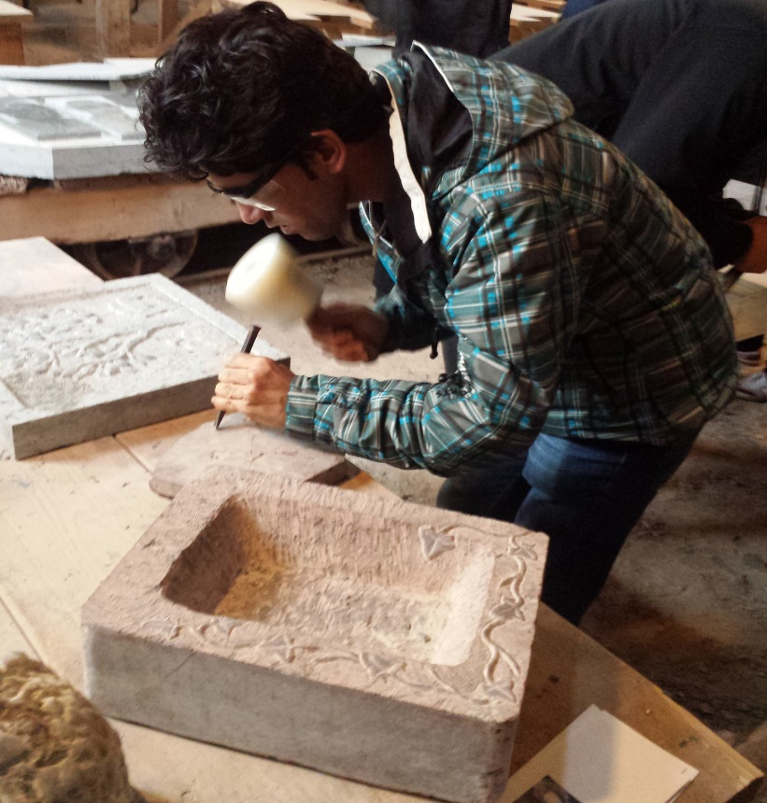
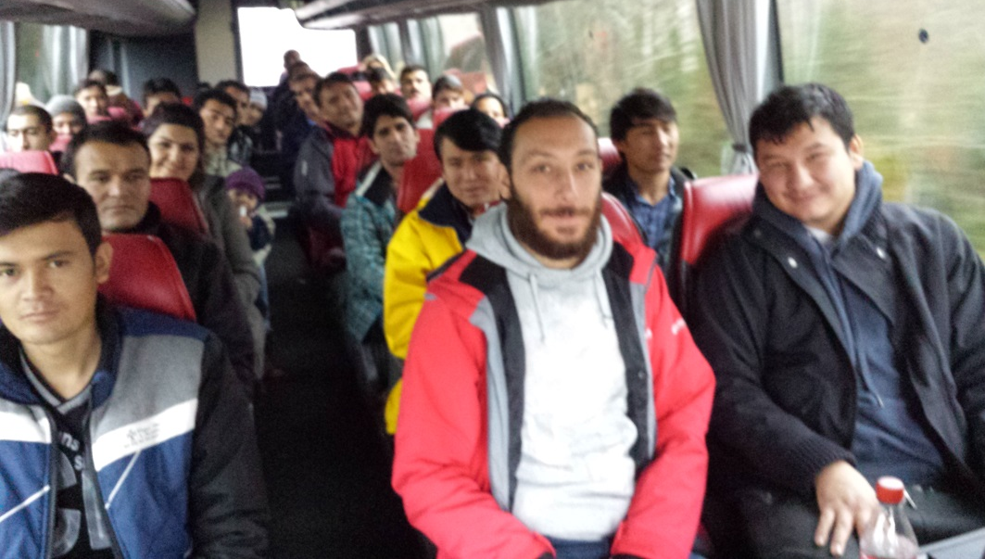

Slide 6
Ali and Mardiah a family from Afghanistan, they said it was nice to see such a place and know a great geological informations about kinnekulle area.
Mohammad, Nesrin and their daughter Janna from Syria said : what a charm place that give an image about hand stone work in Kinnekulle... amazing.
Mohamed from somalia was intersted about process with limestone how it is digging, surfacing, cutting then polishing.

Slide 7
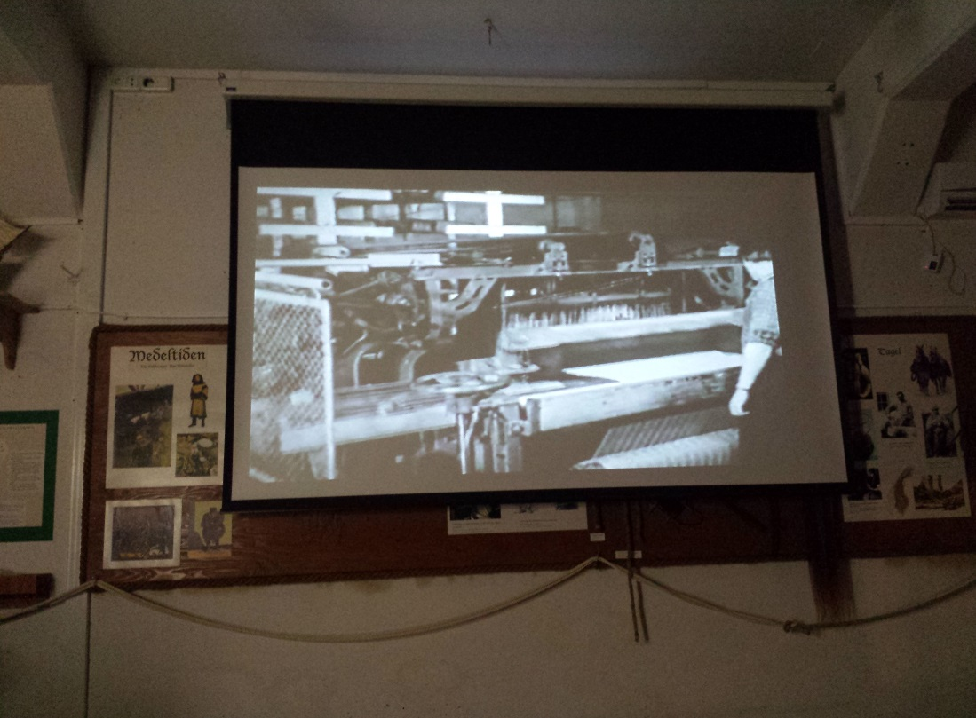
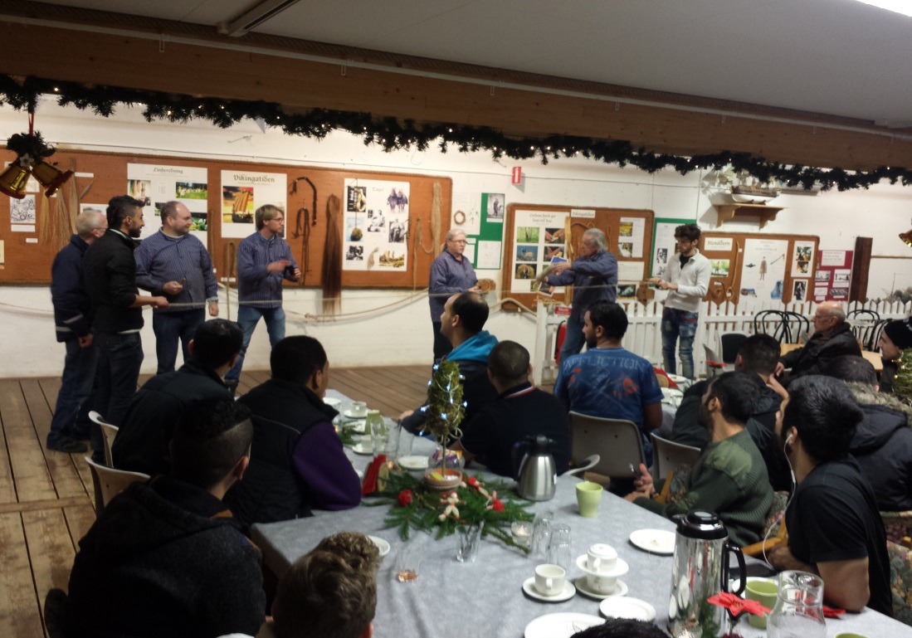
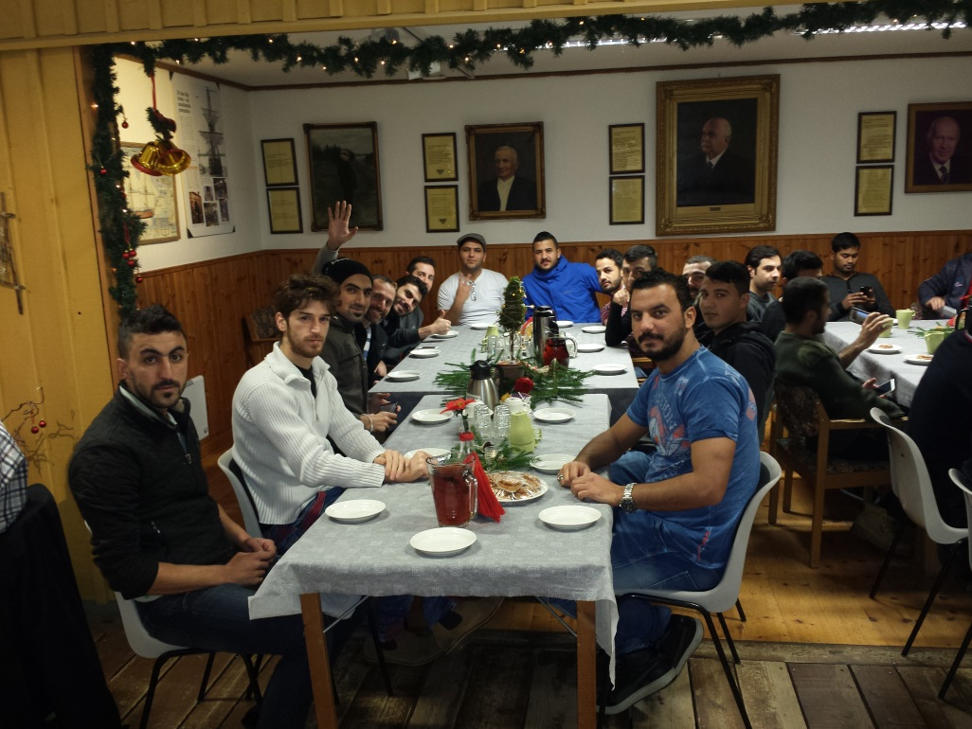
In 11-12-2015 a group of 30 people
from Svenshögen have been to Repslagarmuseet I Äalvängen.

Slide 8
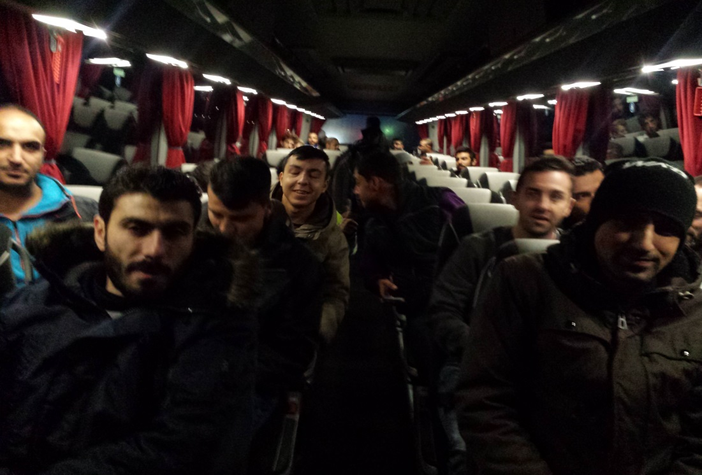
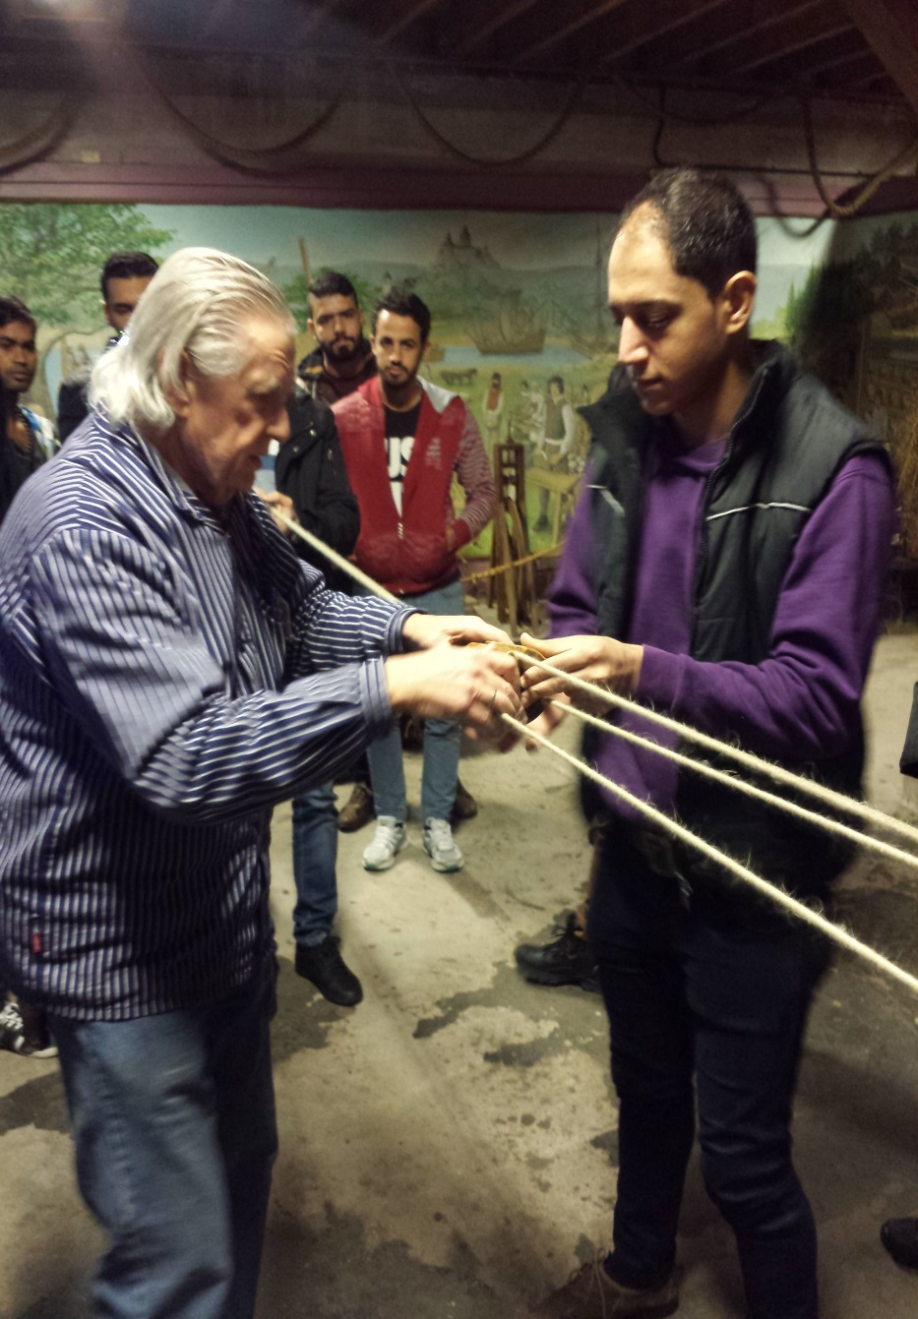
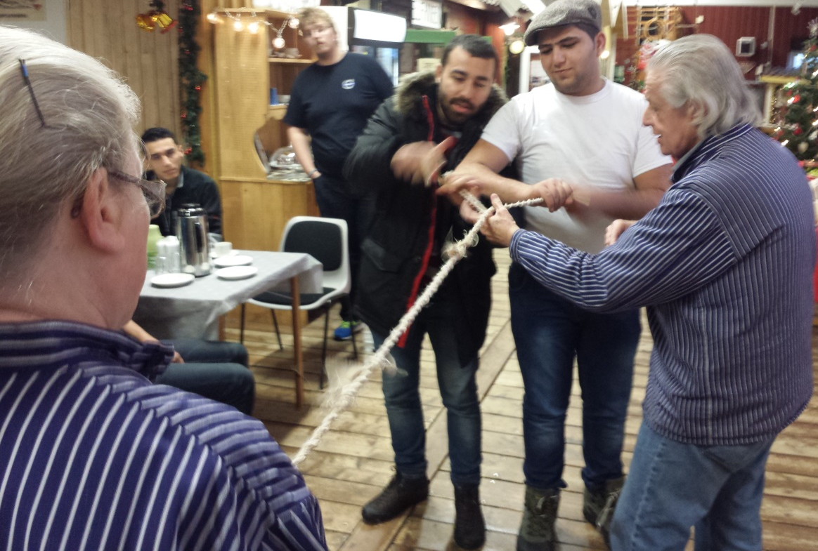

Slide 9
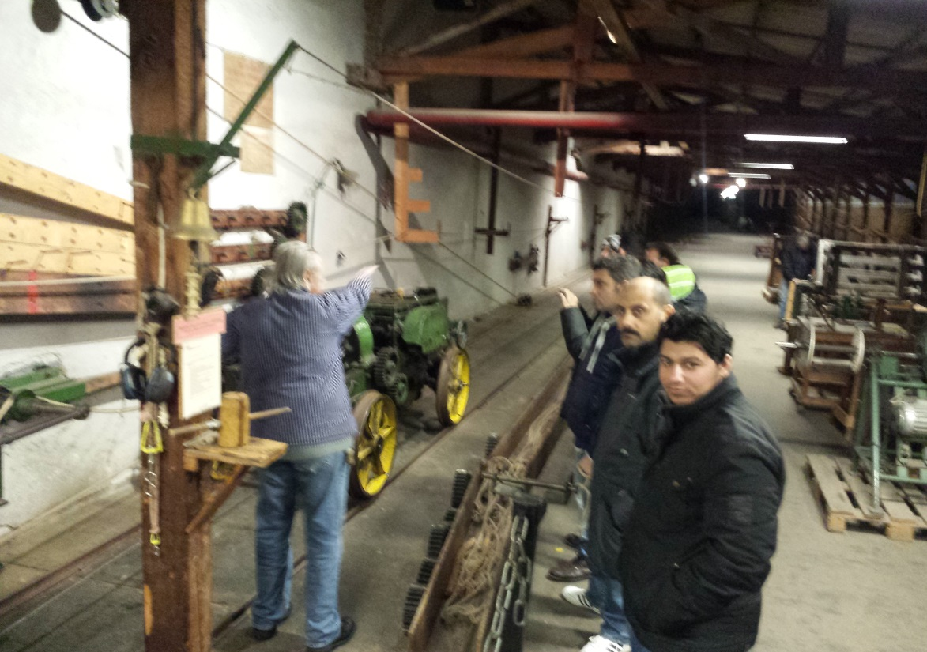
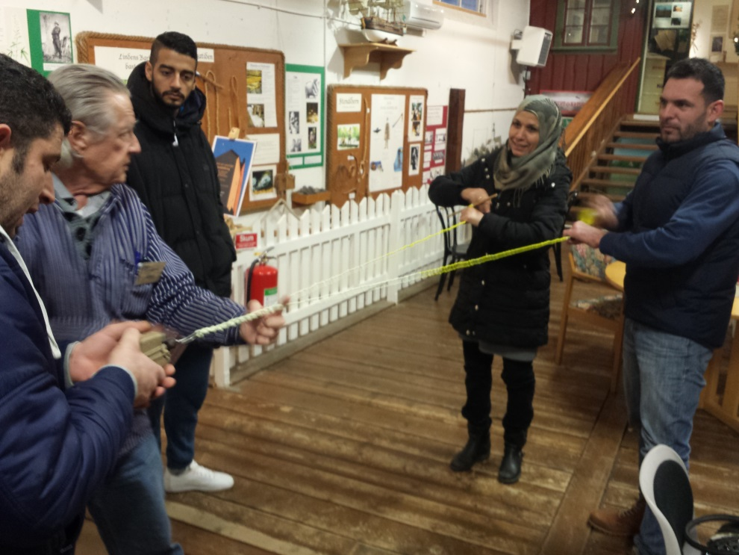
In 16-12-2015 a group of people
from Svenshögen have been to Repslagarmuseet I Äalvängen.

Slide 10
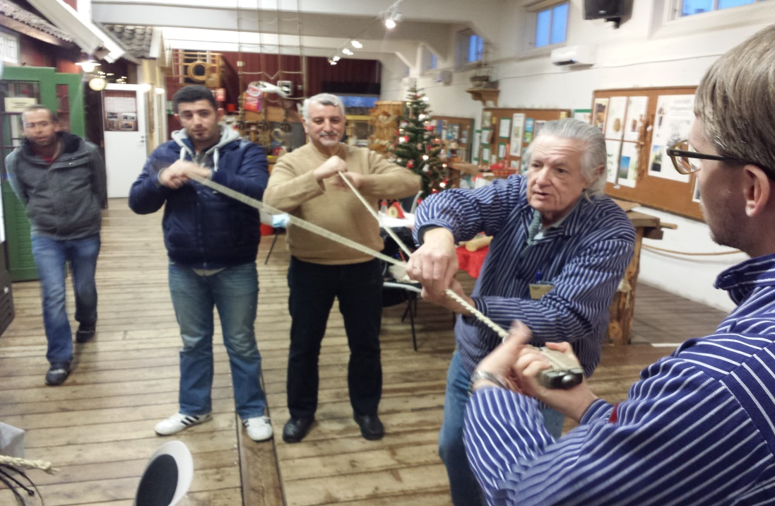
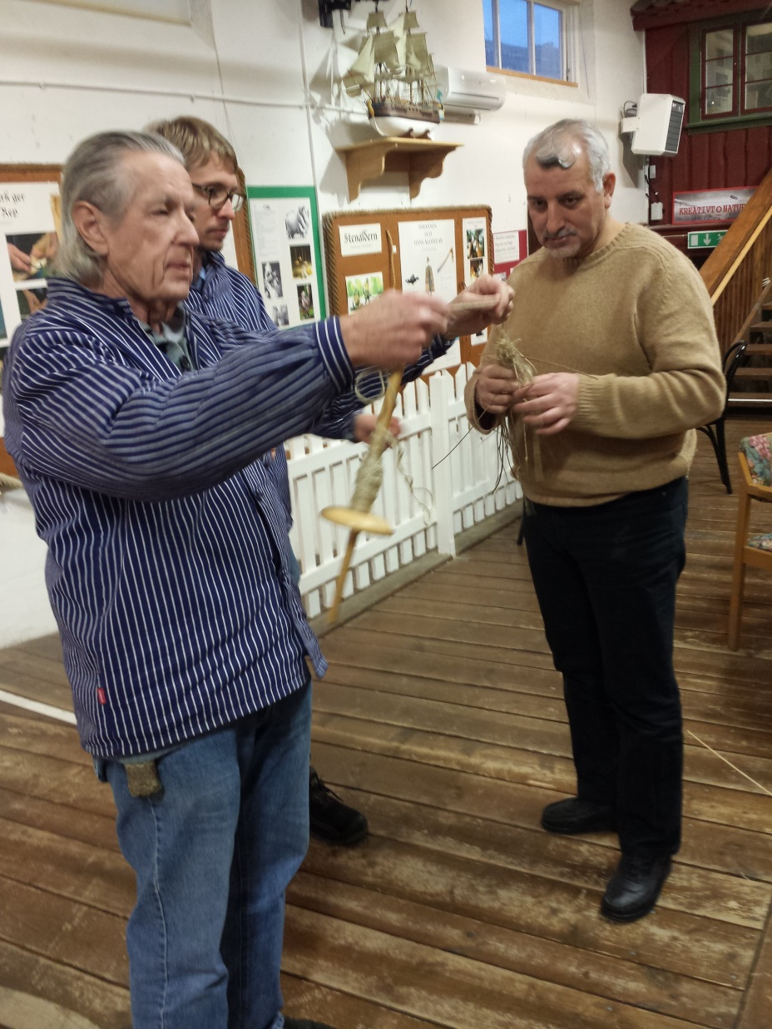
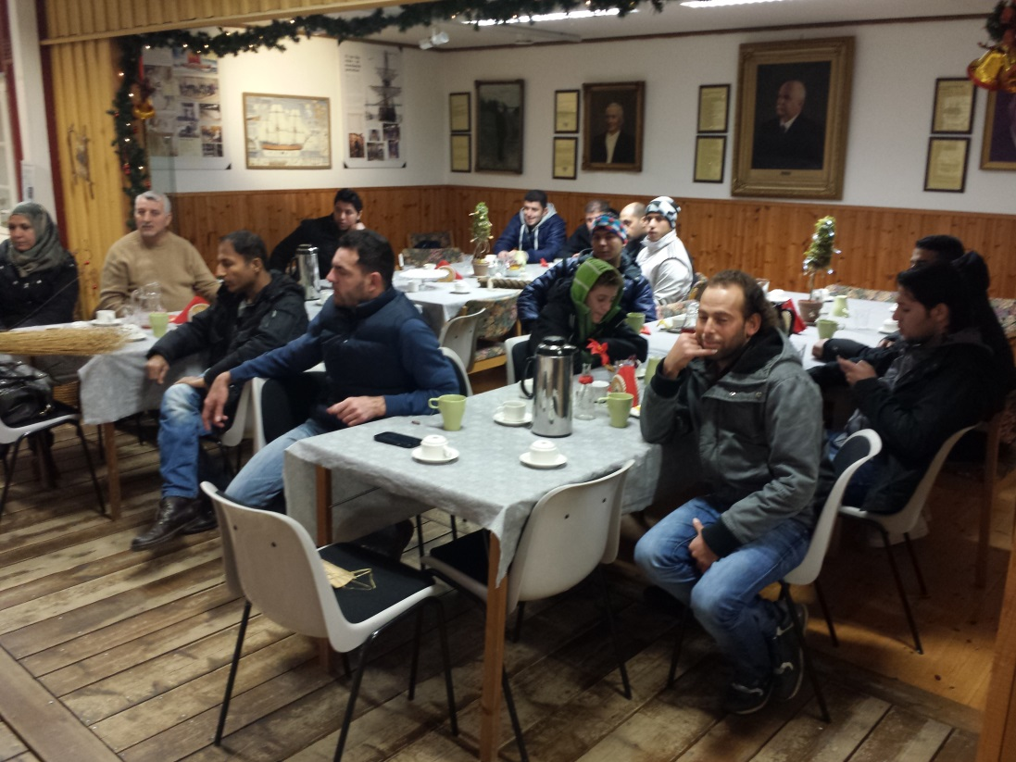

Slide 11
Abo Feras form Syria , and his wife
they have been to Repslagarmuseet and they made some ropes with their own hands
they said it’s a nice experience to know how it all started, thousands of years ago, nice informations we got that day.
Sabri, from Kurdistan was also at the Repslagarmuseet visit, he sais: I’m impressed of how old this place is and how they keep it active until now, even if it’s not and active factory right now, but it’s a reminder for the people who visit this place, about how speacial it is, or was.

Slide 12
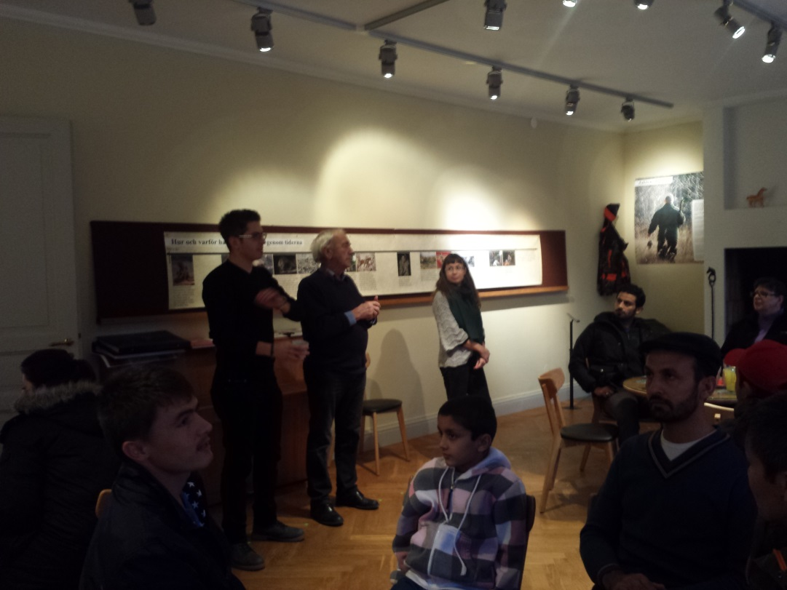
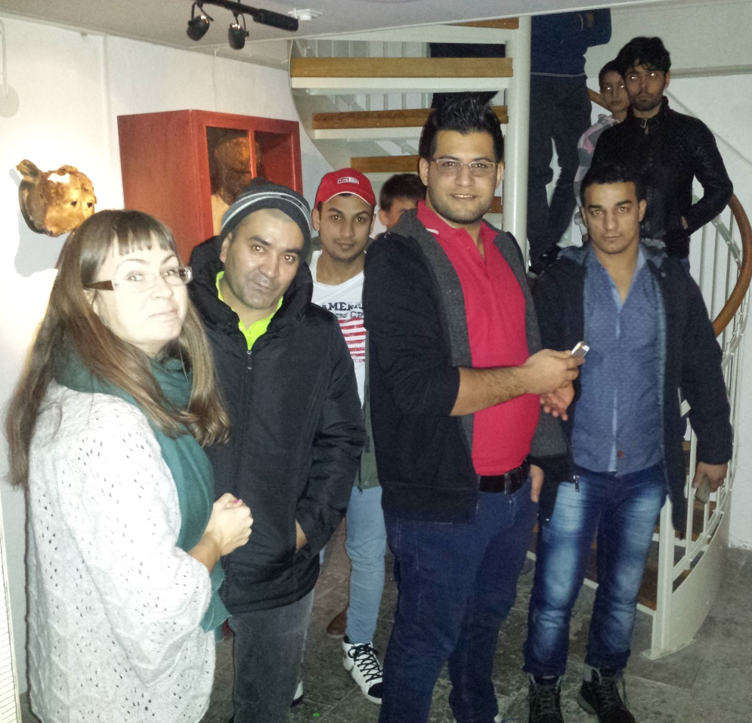
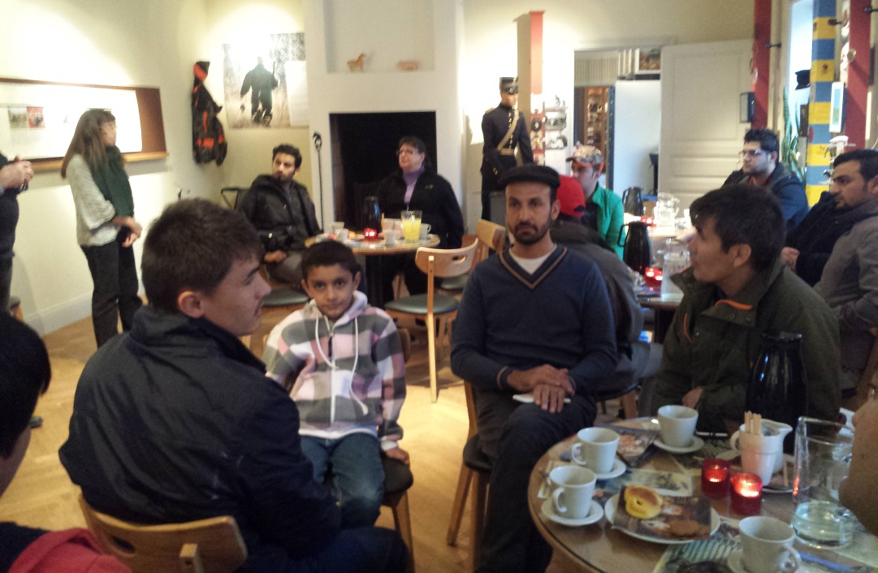
In 15-12-2015 a group of.
20 people from Stora Ekeberg
have been to Veterinärmuseet
I Skara.

Slide 13
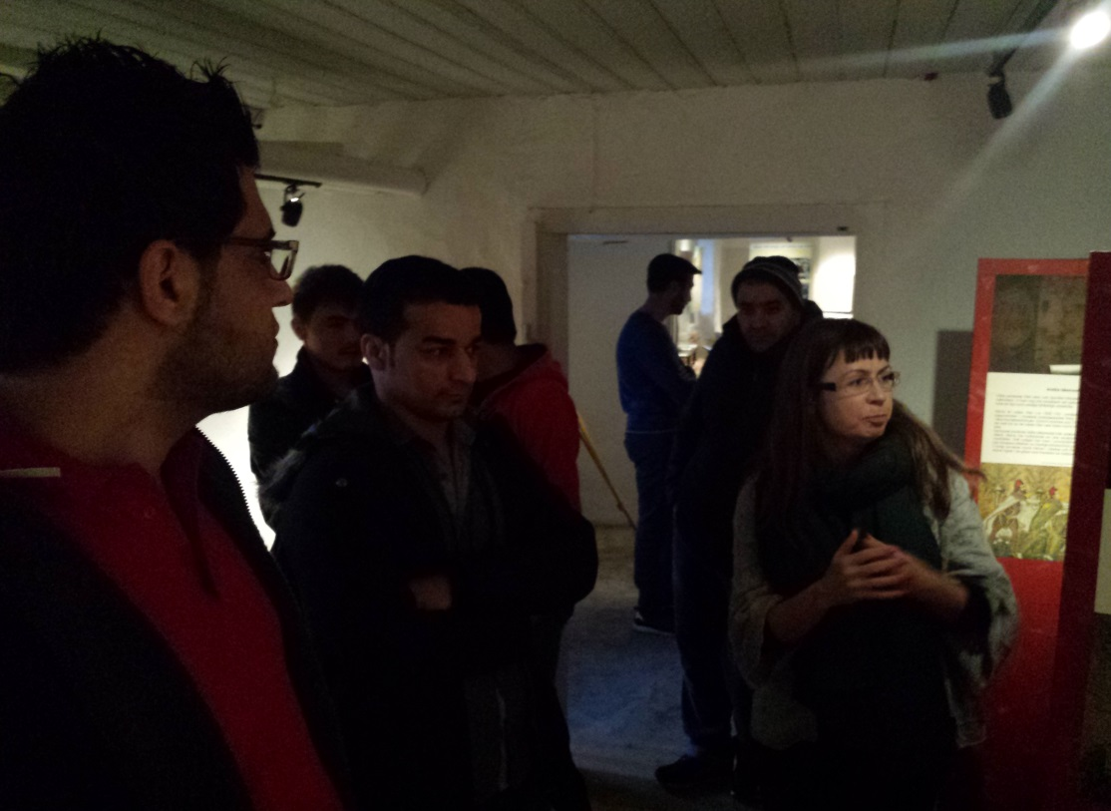
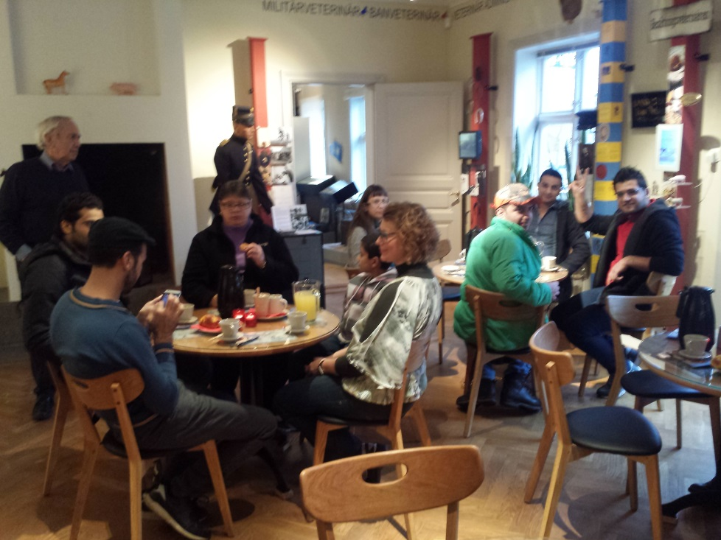
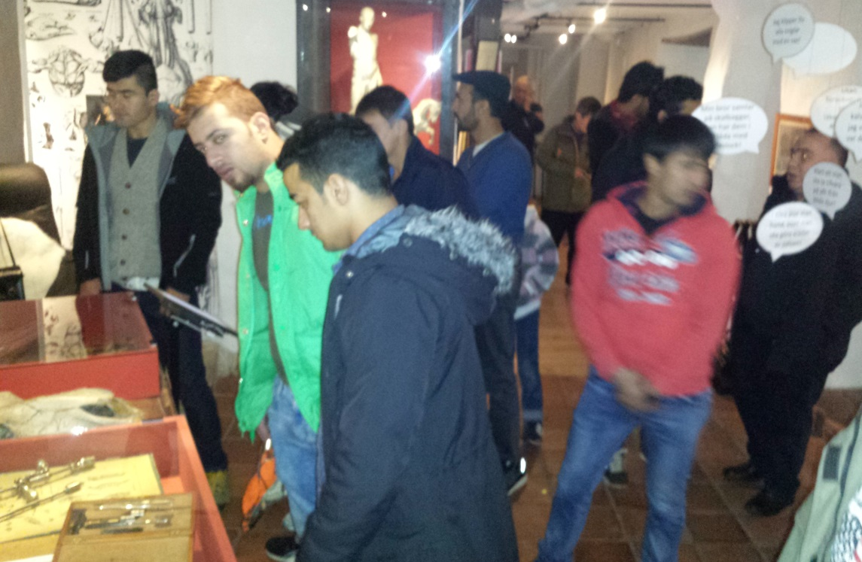

Slide 14
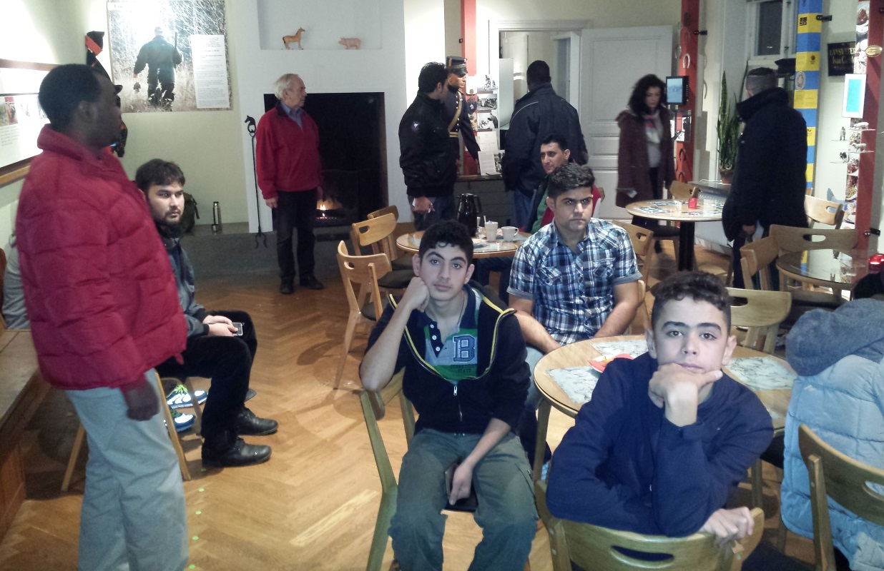
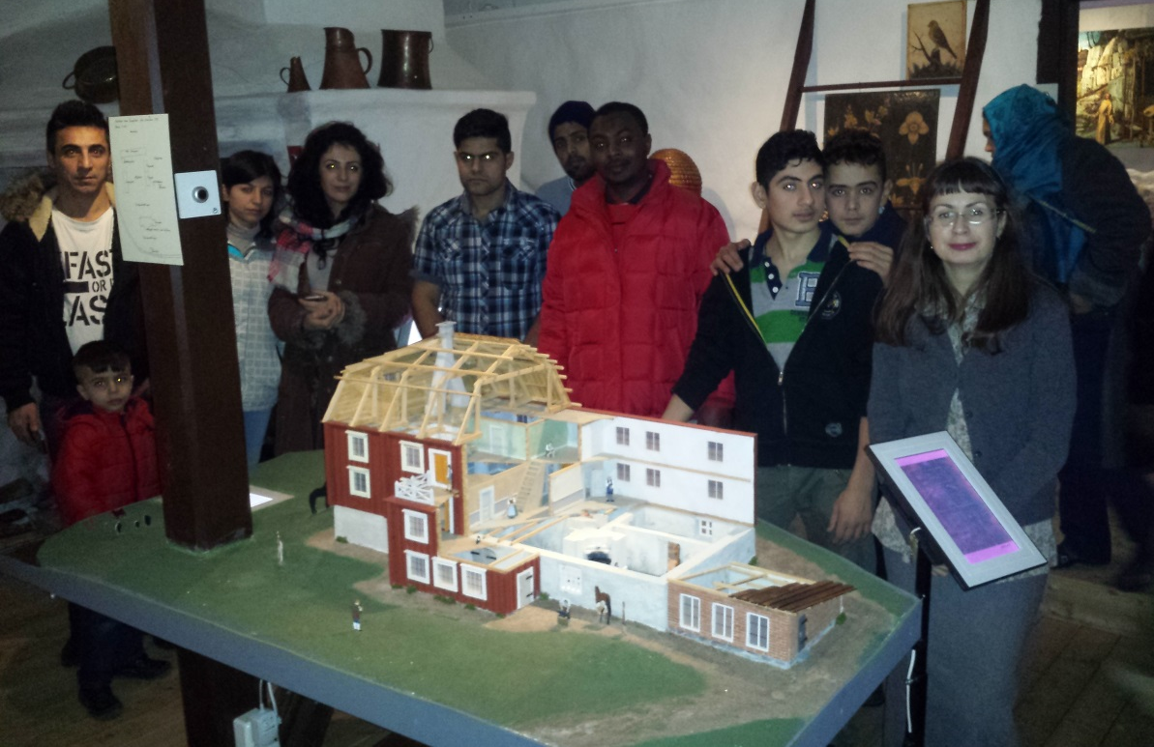
In 18-12-2015 a group of 30
people from Stora Ekeberg
have been to Veterinärmuseet
I Skara.

Slide 15
